Slide 1
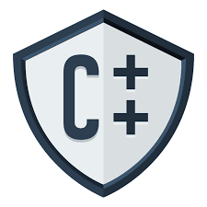
CSE202 OBJECT ORIENTED Programming

Slide 2
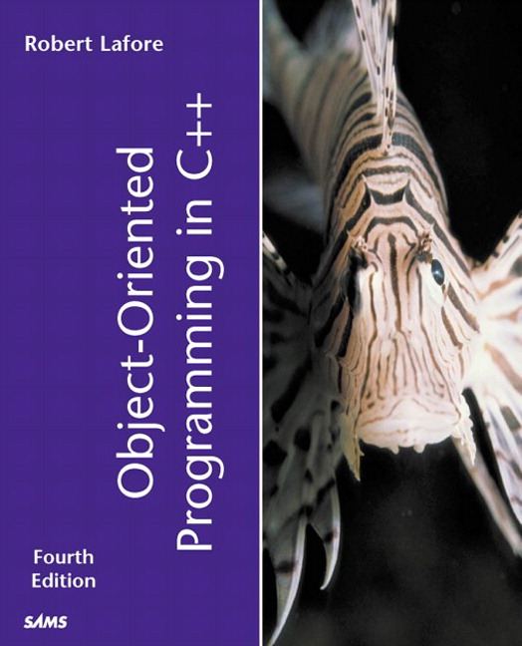
Course Details
[Five Hours/week]
Text Book
“OBJECT ORIENTED
PROGRAMMING IN C++”
by
Robert Lafore
L | T | P
3 | 0 | 2

Slide 3
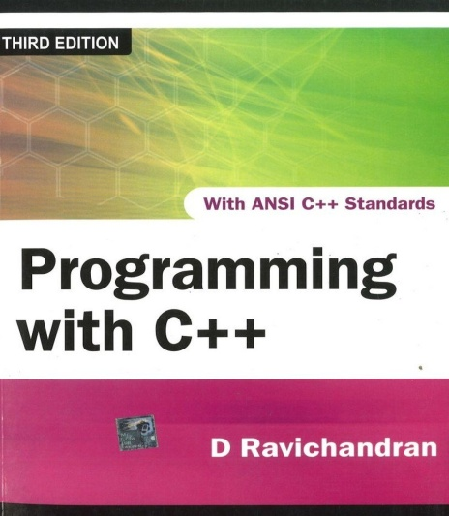
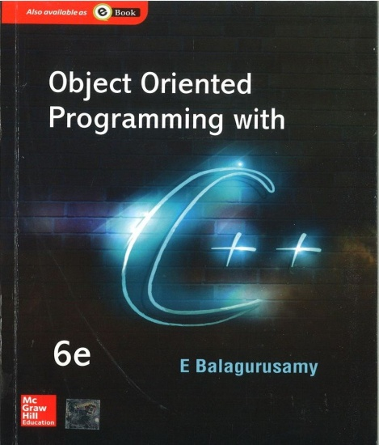
Reference Books
PROGRAMMING WITH C++
by
D RAVICHANDRAN
OBJECT ORIENTED
PROGRAMMING IN C++
by
E BALAGURUSAMY

Slide 4
Course Assessment Model
Marks break up
Attendance 5
Academic Task 30
MTE 20
ETE 45
Total 100

Slide 5
Academic Task
Component Week
Test1 6th
Test 2 9th
Mini Project(Allocated in 2nd week) 11th
Total Weeks: 14( 7 Before MTE and 7 After MTE)

Slide 6



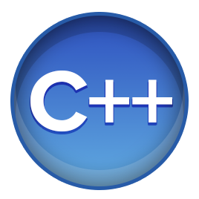
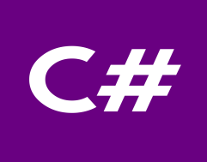

Flashback………..
What C language can do?????
Device drivers are written in C language.
All these modern programming languages are influenced by C language
Compilers for Python and PHP language are also written in C language
Embedded systems are also developed with the help of C language

Slide 7





Last but not the least
Our operating systems either it is WINDOWS, LINUX, UNIX or UBUNTU all are written in C language
And many more…………

Slide 8

The hitch……
Some burning questions in mind......
Is C the only language behind the development of all these powerful softwares
Why C++?
How C++ is different from C language?
Is there no scope of this language in industry?

Slide 9
Is C only language?????
Lets answers your questions
No, C is not the only language for the development of all these powerful system
If we talk about Windows operating system, only Kernel is written in C language rest all other features are provided with the help of C++ language

Slide 10
How does it differ from C
There is no strict type checking (for ex: we can pass an integer value for the floating data type) available in C.
There are no means of providing security.
C doesn't support inheritance, makes it more complex to use because everything has to be written from scratch.
C is not able to represent real world modelling

Slide 11






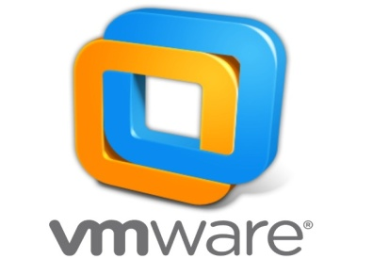
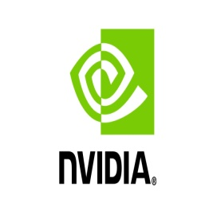




No scope of language in Industry
Top rated Companies which has a dearth of C++ programmers

Slide 12
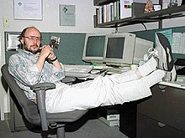
Introduction to C++
In 1979, Bjarne Stroustrup, began work on "C with Classes”
The motivation for creating a new language originated from Stroustrup's experience in programming for his Ph.D. thesis.
Stroustrup found that Simula had features
that were very helpful for large software
development, but the language was too
slow for practical use, while BCPL was fast but
too low-level to be suitable for large
software development.

Slide 13
WHY C++?????
Lets see

Slide 14
Key features of C++
Object and Classes
Real world modelling
Encapsulation
Wrapping
Data Abstraction
Hiding of non required information
Inheritance
Reusability

Slide 15
Key features of C++
Polymorphism
Many forms
Data Hiding
Security
Message Passing
Communication

Slide 16

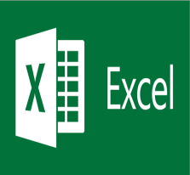



Applications
Git
 | Microsoft Excel
Oracle Database
 | MySql
Linux
 | Unix
Android
 | Google

Slide 17
Course Contents
Before MTT | After MTT
Classes and Objects | Operator Overloading
Functions | Type Conversion
Pointer Array String | Inheritance DMA Polymorphism
Constructor and Destructor | Exception Handling
File Handling | Templates and STL

Slide 18


Difference between POP and OOPS

